Slide 1


Process of Deploying from localhost development server to live server

Slide 2
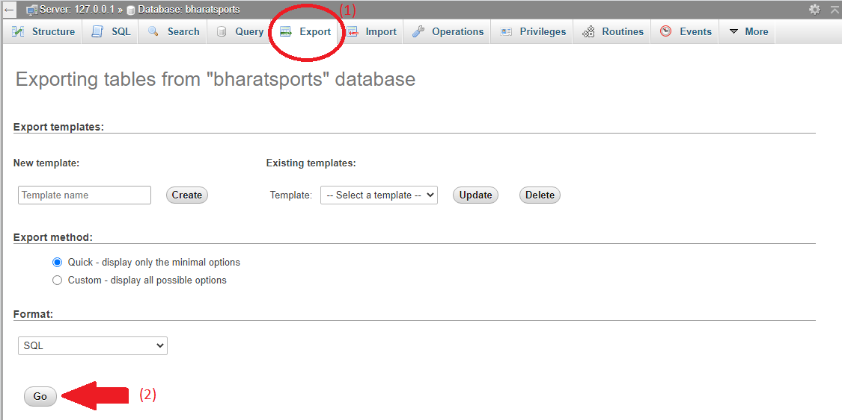
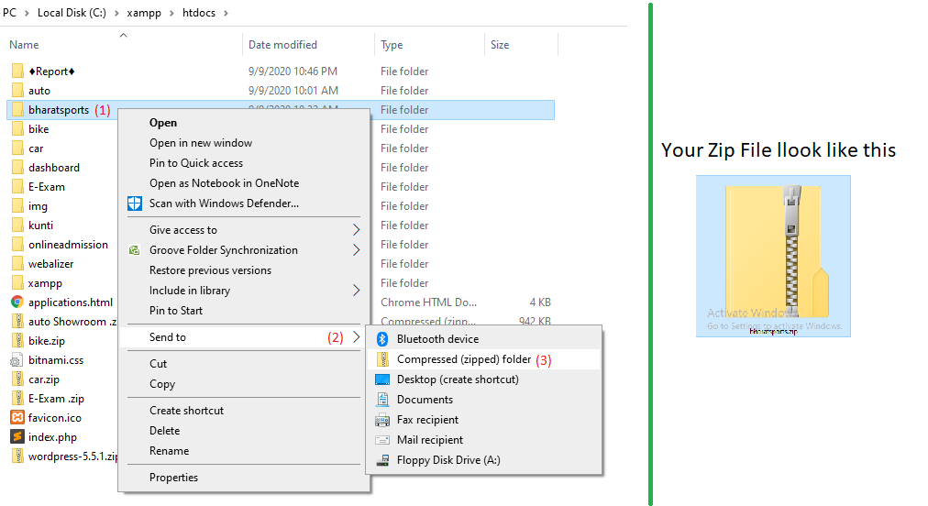
Some Process you Need to perform on your PC
Export Your Database on Project folder in your htdocs folder,
Make zip of your Project Folder,

Slide 3
Now, we need to an address by which users can access your website on internet that is DOMAIN.
And also we need web server space where we can store our website code and corresponding files that is WEB HOSTING.
There are many Domain & Hosting provider over Internet from where we can purchase it separately.
In this slide, We take example of .com

Slide 4
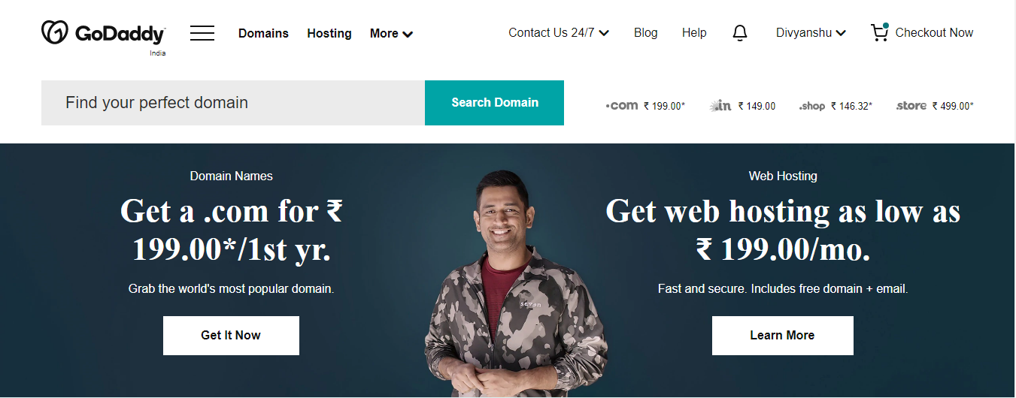
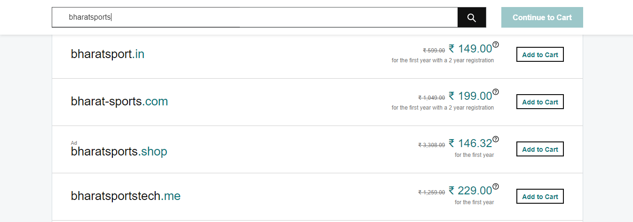
How to choose and purchase your domain
from
godaddy.com
You can search here your domain

Slide 5
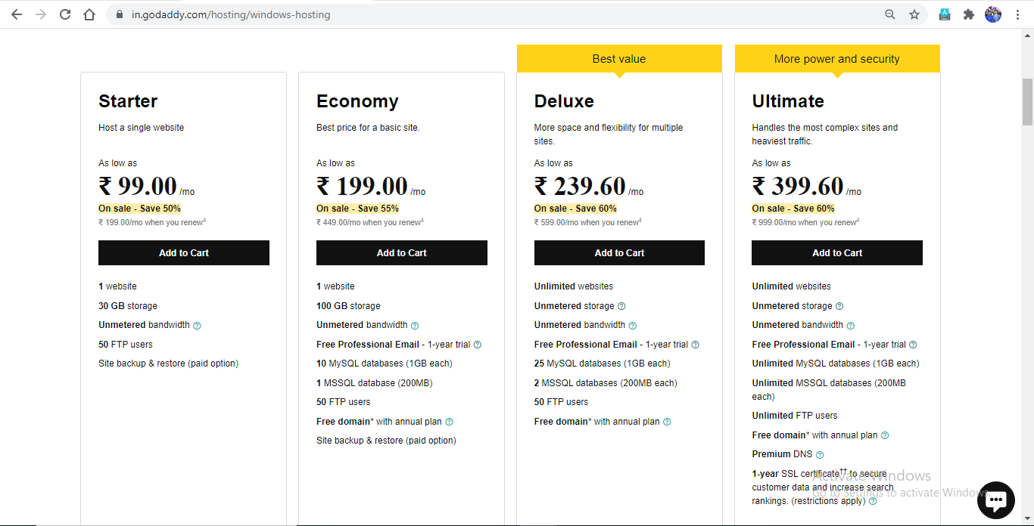
How to choose and purchase your Hosting
from
godaddy.com
We choose this plan for web hosting my website

Slide 6



After Purchase Domain & Web Hosting
“Connect Your Domain With Hosting”

Slide 7
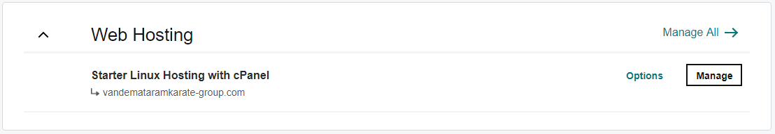
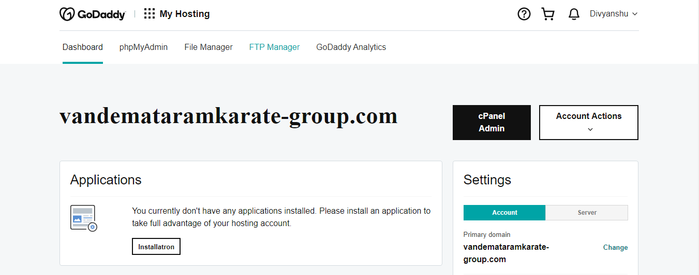
Sign in to godaddy account
Goto my product
Then click on WebHosting -> Manage
Then click to Server
Copy IP address from there.

Slide 8
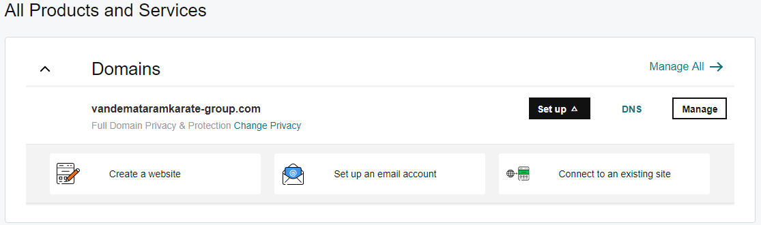
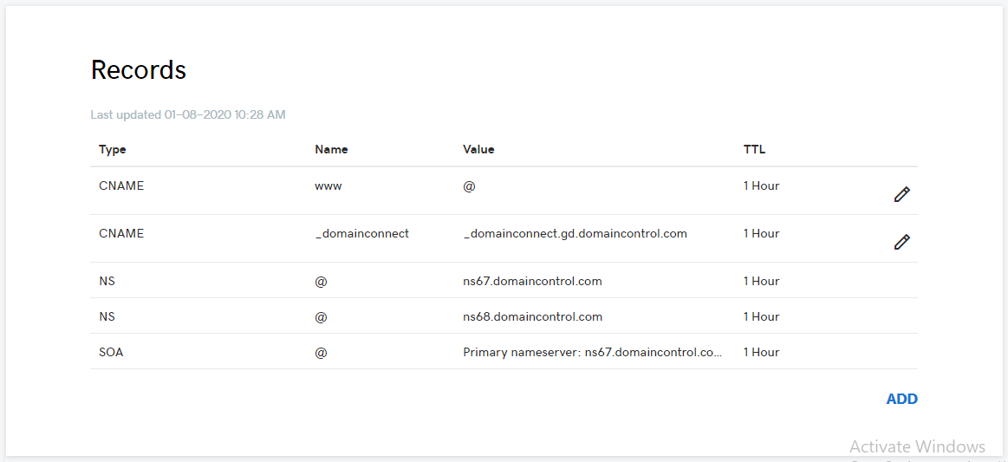
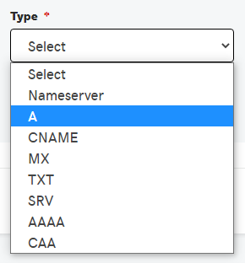
Goto my product
Then click on Domain-> DNS
Then click to ADD and select ‘A’
Fill the following information as like as shows in under green dashed box.

Slide 9
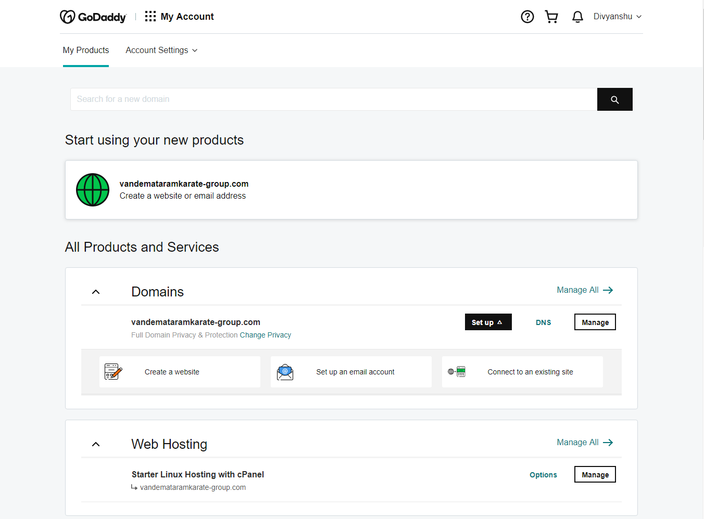
The next step -> Open My Product
Then click on -> Hosting -> Manage

Slide 10

From here we can open cPanel

Slide 11
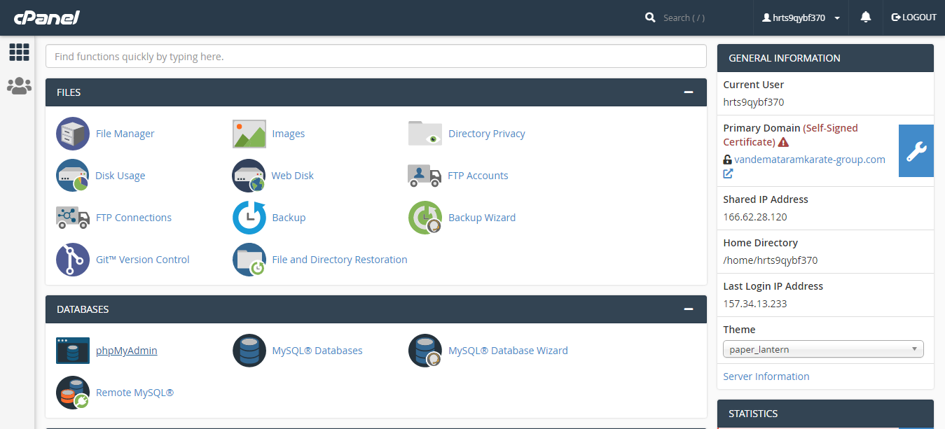
Goto MYSQL® Database Wizard to make database and username & password .
MYSQL® Database Wizard – MYSQL Database Wizard is a step by step process to create a MySQL database and user and finally adding the user to user to access the database . To use this interface ,we will need to open MySQL Database Wizard ,which can be found in the database section of cPanel Home .

Slide 12
Goto file manager to Upload or Save your project
cPanel File Manager - gives you useful options to quickly manage your files within the cPanel interface. It's easy to use and it removes the hassles of using FTP. You can create, upload, modify or remove files from this interface.

Slide 13

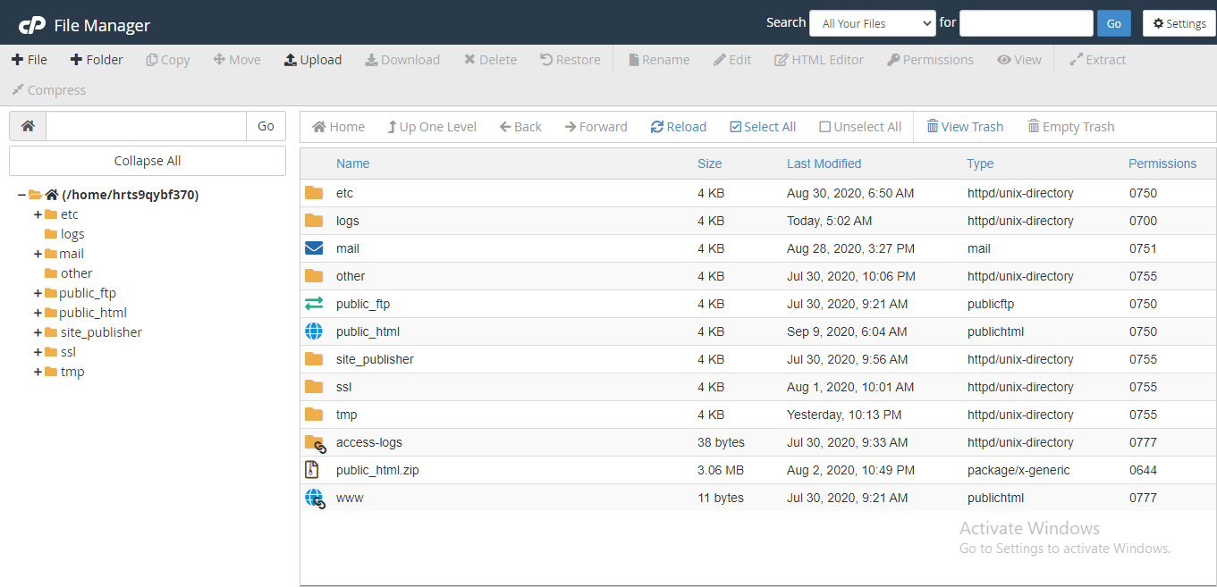
public_html is the folder where you put all website files which you want
to appear when someone types your main domain.

Slide 14
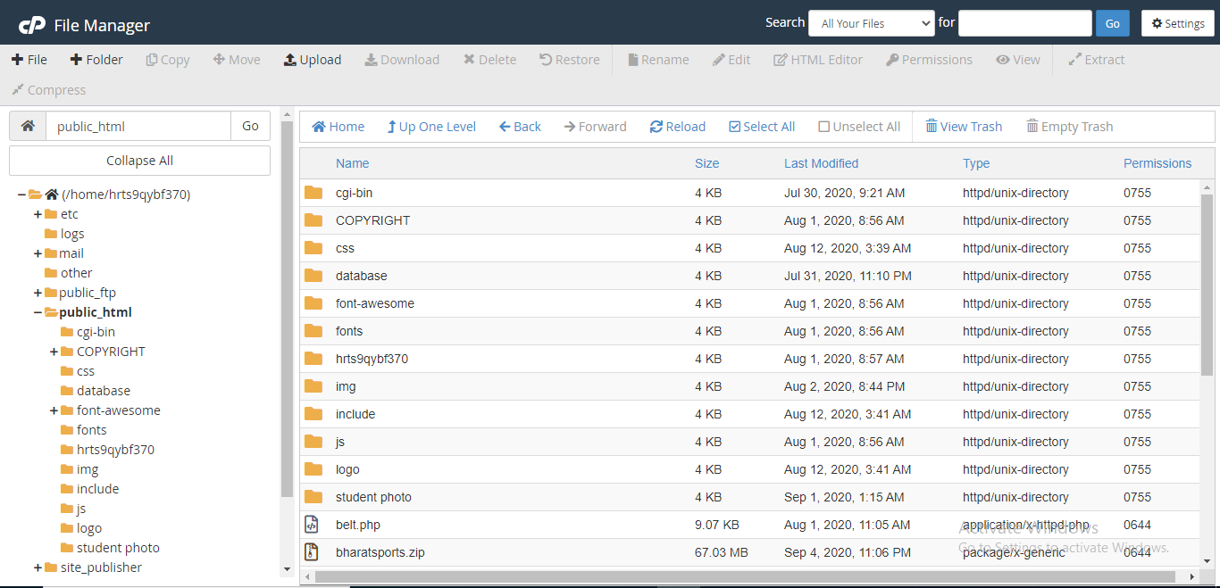
Click to Upload button to upload your project

Slide 15
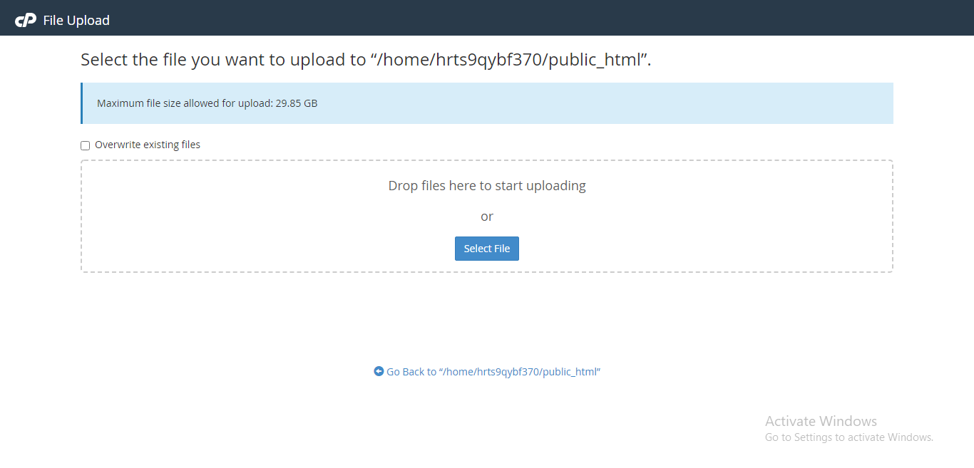
Click to Select File button to upload your project

Slide 16
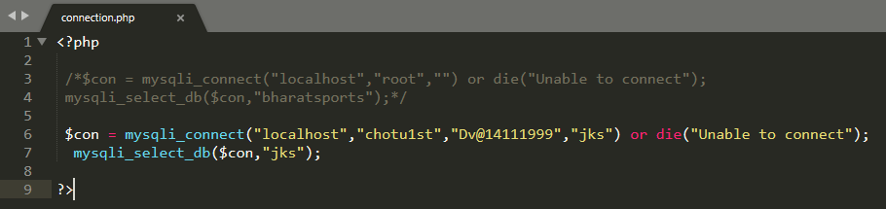
Change your connection page because now your are working on live server.
Here we comment our localhost connection
and
make another connection with username and password
Which you had created in MYSQL® Database Wizard

Slide 17
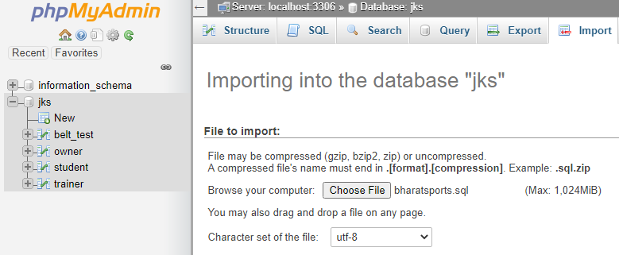
Now the last step is to “Import ” your database on phpmyadmin of the cPanel
Upload your sql file which you had “Export” before !

Slide 18


Now
the Website
is ready to work

Slide 19
Thank You
Presented By –
Divyanshu Shrivastava & Juhi Singh

